Slide 1
IoT Data Storage
Using Azure

Slide 2
Structured vs. Unstructured Data
Structured Data
  Well-defined, rigid structure
  Maps to tables with relationships
  Example: Person's details (name, DOB, address)
Semi-Structured Data
  Flexible, but has some structure
  Maps to documents or key-value pairs
  Example: JSON object with person's details (name, DOB, address, optional fields)
Unstructured Data
  No rigid structure
  Can change frequently
  Example: Documents, spreadsheets, IoT data
IoT data is typically unstructured data.

Slide 3
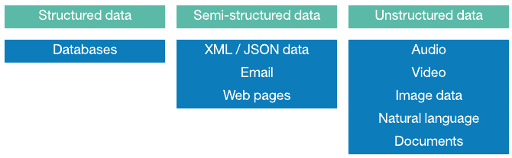
This Photo by Unknown Author is licensed under CC BY-SA

Slide 4
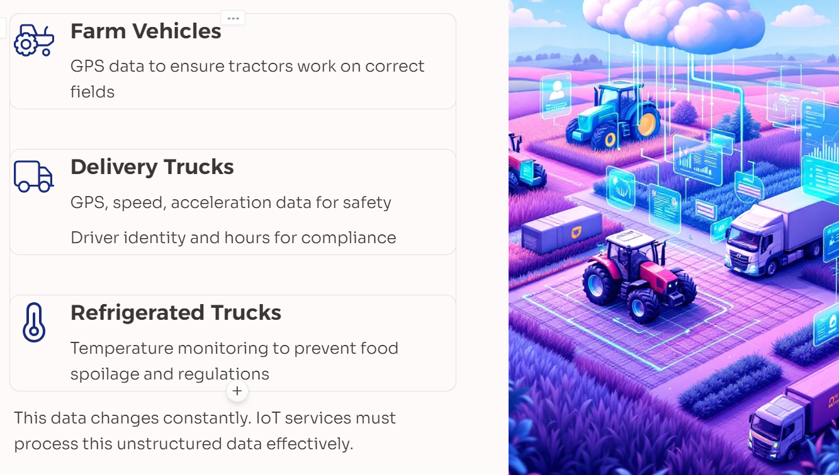
IoT Data Examples

Slide 5
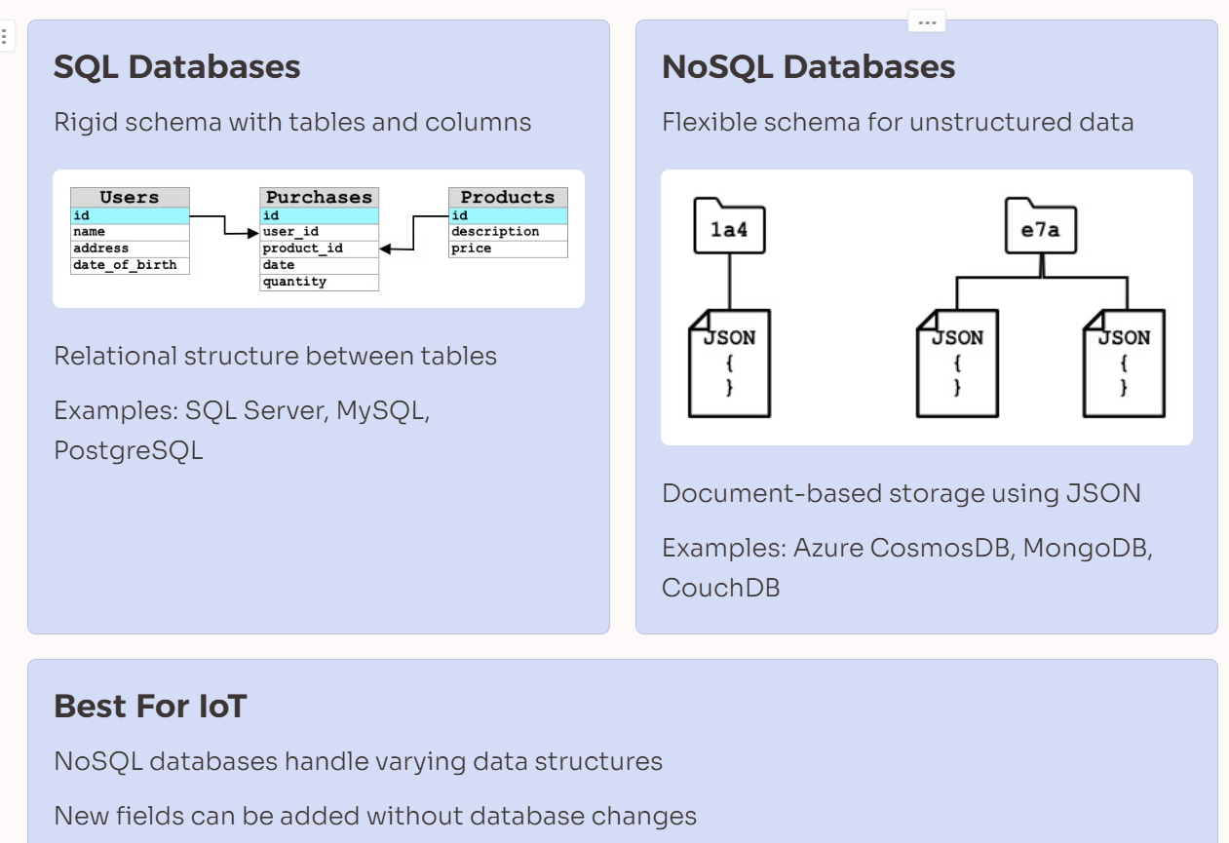
SQL vs NoSQL storage

Slide 6
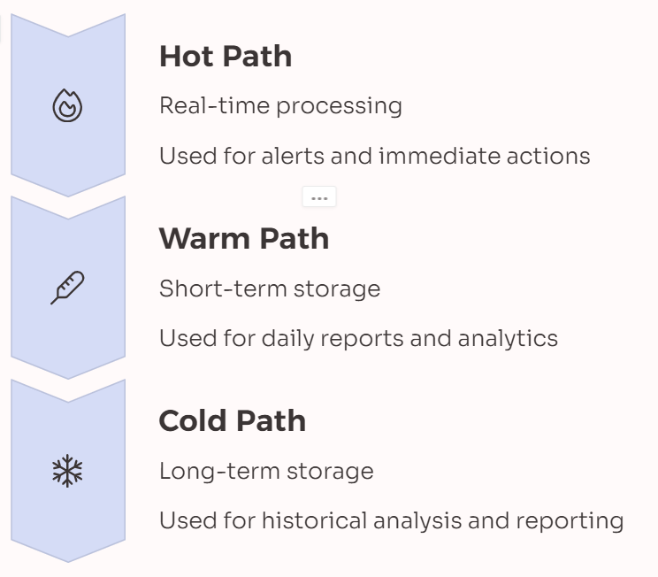
Hot, Warm, and Cold Data Paths
Data that flows from an IoT device to the cloud is not always processed in real time.
Some data needs real time processing, other data can be processed a short time later, and other data can be processed much later.
The flow of data to different services that process the data at different times is referred to hot, warm and cold paths.

Slide 7

Azure Storage Account
Azure provide a variety of storage solutions
General purpose Storage accounts provide a unified platform for all Azure Storage services.
Blobs are ideal for storing unstructured data like text, images, and media files.
Tables store structured/semi structured NoSQL data in the cloud, offering a key-attribute data store.
Queues provide a reliable messaging solution for asynchronous communication between application components.

Slide 8
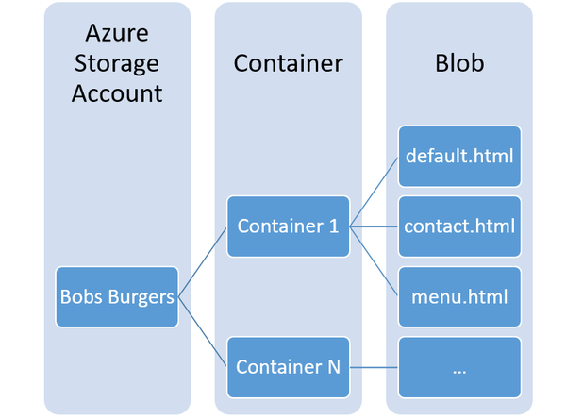
Blob Storage
Binary Large Objects
  Store any unstructured data, from JSON to images
Organised in Containers
  Named “buckets” with folders and subfolders
Scalable
  Useful for varying IoT data structures
This Photo by Unknown Author is licensed under CC BY-SA

Slide 9
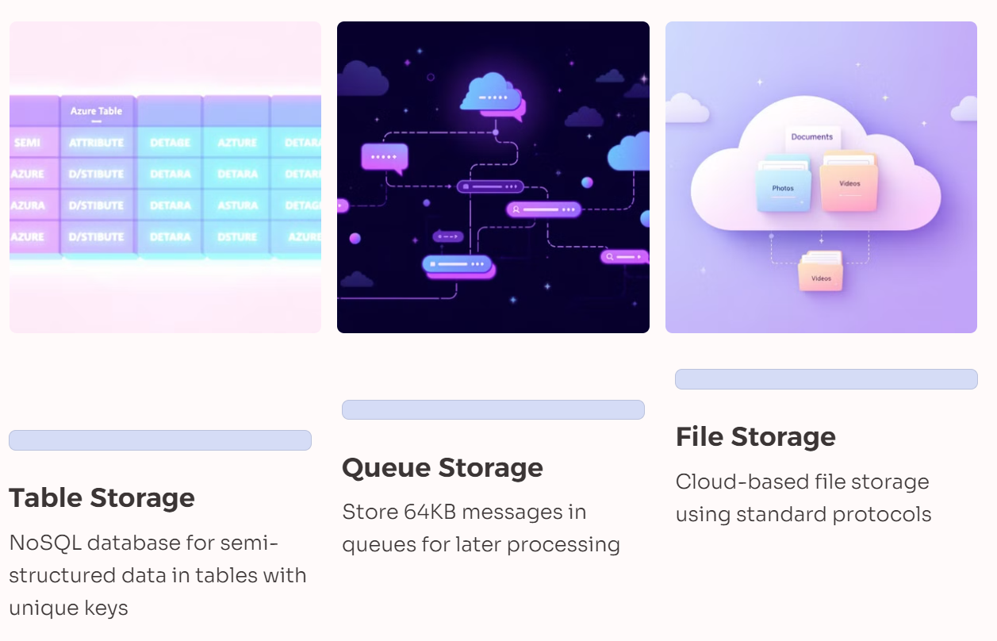
Other Options…

